Slide 1

CORRELATION WITH S-PLANE POLES AND ZEROS

Slide 2
SUMMARY OF PREVIOUS LESSON
To design a CS we must first define the system specifications to correspond to the desired (system) performance.
As CSs are by their nature dynamic, we shall characterize system response to standard test signals in terms of:
  Transients (die out with time)
  Steady-state accuracy (exists long after application of input test signal)
The design specifications normally include time-response indices for a specified input test signal and the desired steady-state accuracy.

Slide 3
s-Plane root location and transient response
The transient response of a closed-loop FBCS can be studied in terms of the location of the poles and zeros of its transfer function(tf).
For a closed-loop system, the poles of the tf are the roots of the characteristic equation/polynomial.
The poles of the tf determine particular response mode that will be present and the zeros will establish the relative weightings of the individual mode functions...moving a zero closer to a specific pole will reduce the relative contribution of the mode function corresponding to the pole.
We must try the matlab approach!

Slide 4
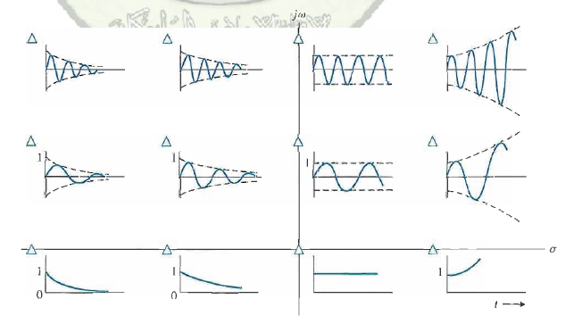
Impulse response for various root locations in the s-plane

Slide 5
Design example-English channel boring machines
Construction of tunnel between France and UK started in De 1987; first connection of the boring tunnels from each country was achieved in Nov 1990
Machines bored toward the middle and they must meet in the middle with the required accuracy with the help of a laser guidance system.

Slide 6
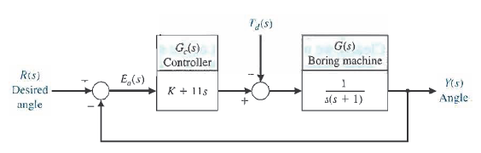
Block diagram model of boring machine control system
The output, Y(s) is the actual angle of direction of travel of the boring machine, R(s) is the desired angle.
Td(s) is the disturbance on the boring machine.
Design objective: select the parameter K so that response to R(s) changes is acceptable while Td(s) produces minimal error.

Slide 7

System transfer function

Slide 8
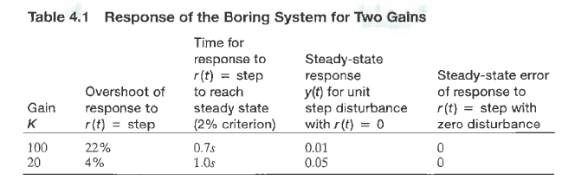
System response with varying K – matlab exercise to follow

Slide 9
Steady-state error of FBCS
ss error is the amount of deviation from the desired response after the transients have died out.
Feed back can help improve ss despite the cost involved... imagine the consequence of ss error in reading data from a hard drive.

Slide 10
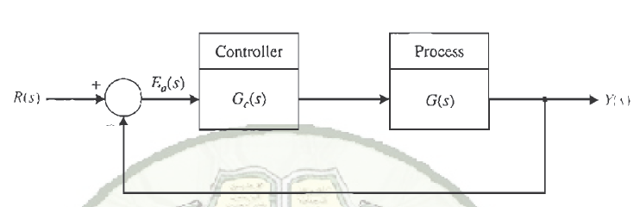
ss error
Derive the expression for the error, Ea(s) for the unity feed back system.
Determine, the limit of e(t) as time approaches infinity of Ea(s).

Slide 11
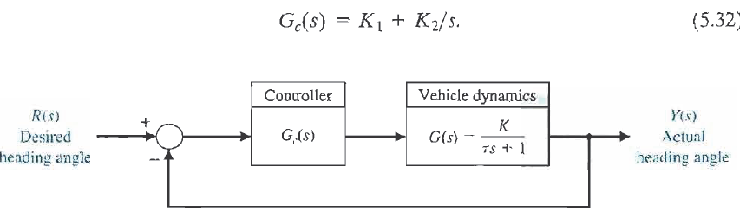
Example – steering control system for a mobile robot
Use matlab to study the effect of the controller const, K2, on system ss...Use the lsim function.

